Slide 1

Smart Document Cleaning & Modification System
A no-code web application for legal document correction, designed for Xerox and document service centres.
Presented by: Vishnupriya Nallabothula
Domain: Document Automation | OCR | Web Application

Slide 2

Challenges in Current Xerox Shop Workflows
Legal Document Imperfections
Staff Burden
Retyping entire documents
Overwriting & Strike-throughs
High risk of errors (typing & formatting)
Smudges in printed text
Degraded document quality
Inefficient use of time
OCR Limitations
Extracts incorrect text
Allows unrestricted editing
Adds to correction workload

Slide 3





Smart Document Cleaning & Modification System: Our Solution
No-Code Web Application
Intelligent Text Extraction
Accessible, user-friendly platform for efficient document correction.
Leverages OCR to accurately extract printed text.
Controlled Editing
Clean, Professional Output
Allows corrections only where truly needed, preventing accidental changes.
Generates pristine, ready-to-print legal documents.

Slide 4

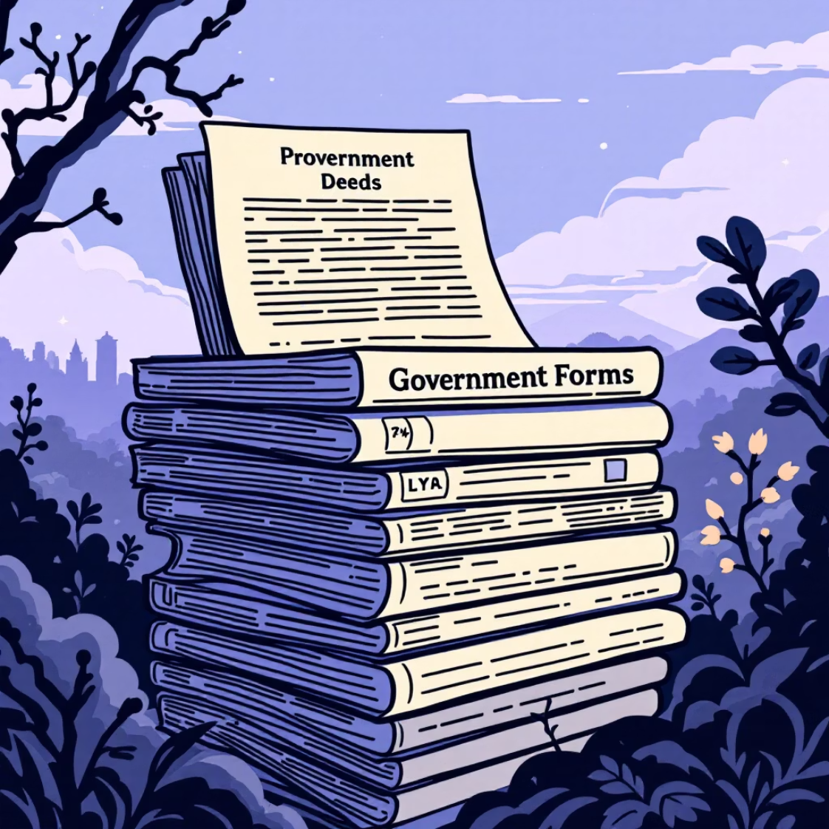
Target Users & Key Use Cases
Primary Users
Diverse Use Cases
Xerox Shop Staff
Bond Papers
Document Service Centres
Land & Property Documents
Legal Document Assistants
Legal Affidavits
Government Forms
Minimal Typing Effort
Faster Processing
Reduced Human Errors

Slide 5
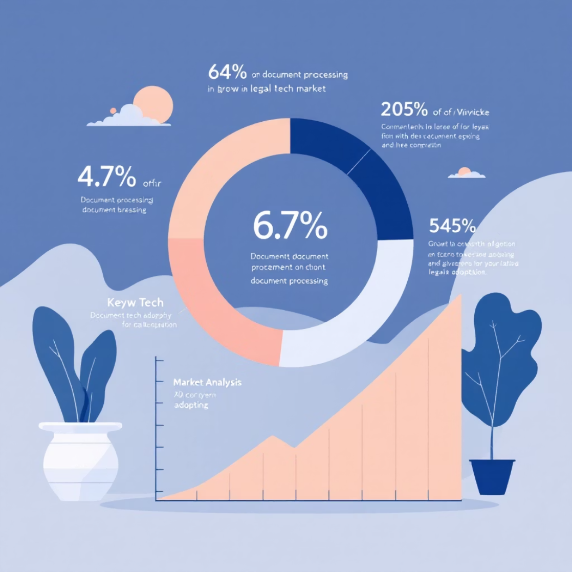

Market Research & Strategic Scope
Significant Market Need
Thousands of Xerox shops process legal documents daily. Manual correction is prevalent, with limited affordable tools for small businesses.
Initially focused on small & medium document service providers within the legal document digitization market.
Banks & Financial Institutions
Law Firms & Corporate Legal Departments
Government Offices & Public Sector

Slide 6





System Architecture & Workflow
Upload Document
Scan (PDF/Image) to system.
OCR Extraction
Printed text extracted by OCR.
Mark Areas
Staff marks sections for modification.
Controlled Editing
Edits only in marked zones.
Review & Finalize
Compare original vs. modified. Download/Print.
Key Design Focus: Simplicity, Accuracy, Speed

Slide 7







Core Features: Precision & Control
Document Upload & Preview
OCR Text Extraction
Seamless file ingestion with instant visual feedback.
Accurate conversion of printed text to editable format.
Manual Correction Zones
Controlled Editing System
Empowers users to define specific editing areas.
Ensures integrity by restricting changes to defined zones.
Side-by-Side Review
PDF Generation & Printing
Easy comparison of original and modified versions.
Final output in professional, shareable formats.
Special Highlight: Prevents editing of untouched legal content, ensuring legal compliance and accuracy.

Slide 8

Technologies Powering the Solution
Frontend
Backend
No-code Platform (Bubble/Glide)
OCR API (Tesseract/Google Vision)
HTML, CSS (UI Styling)
Cloud Storage (AWS/Firebase)
PDF/Image Preview Tools
Version Control
Security Measures
Role-based Access
Secure File Storage
Data Encryption

Slide 9

Advantages & Impact: Driving Efficiency
Business Advantages
Operational Impact
1
Reduced Retyping Effort
1
Decreased Staff Workload
By up to 70%, saving significant time.
Frees up staff for other critical tasks.
2
Improved Processing Speed
2
Higher Customer Satisfaction
Faster turnaround for urgent documents.
Delivers quick, accurate, and professional service.
3
Minimized Legal Document Errors
3
Professional Document Output
Enhances accuracy and compliance.
Consistent, high-quality final documents.

Slide 10


Future Enhancements & Conclusion
Future Enhancements
Conclusion
AI-based Strike-through Detection
A smart, efficient, and user-friendly system that solves real-world Xerox shop problems with strong potential for commercial adoption.
Handwriting Recognition
Regional Language Support
Legal Document Templates

Slide 11
Thank you

